Slide 1

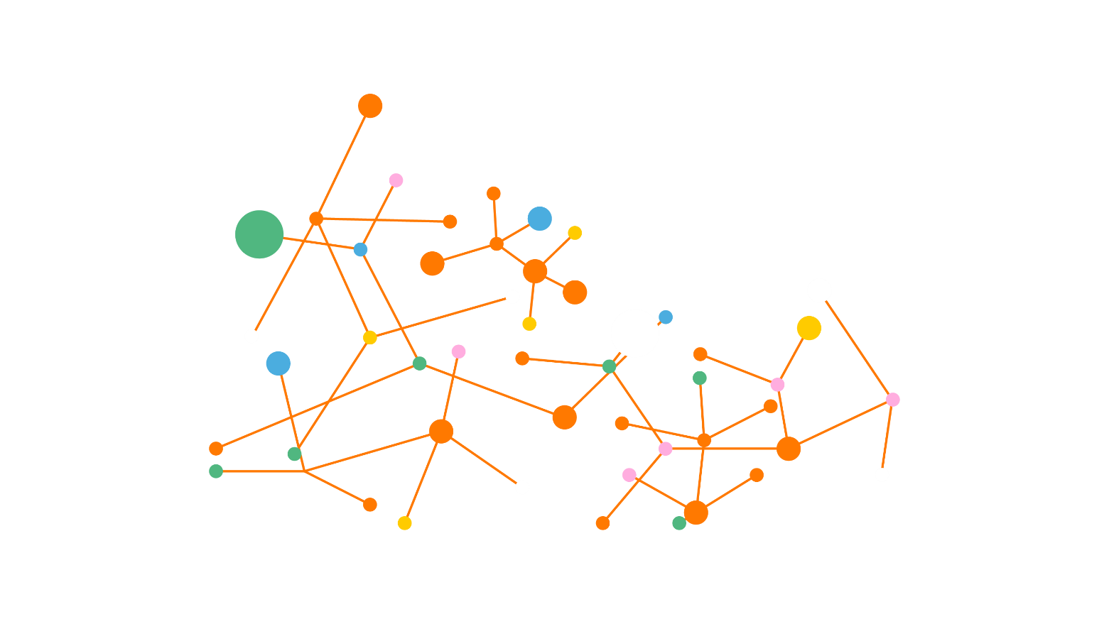

Flexible Engine
Le cloud public sécurisé

Slide 2
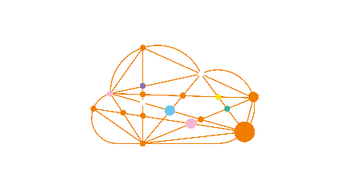

Flexible Engine Edge Demonstration
FLEXIBLE ENGINE
CLOUD
EDGE
1. Develop Edge Application and store in SWR
2. Deploiement
Application à Edge
SENSOR
IOT EDGE
MQTT SERVER
Intelligent EdgeFabric
Software Repository for Container
IOT EDGE
APP CORE
3. Remonter des metriques
Data Ingestion Service
Object Storage Service
EDGE DEVICE
EDGE NODE

Slide 3

Services Flexible Engine
Compute
Elastic Cloud Server
Bare Metal Server
Image Management Service
Auto Scaling
Dedicated Host
Dedicated Cloud
Server Migration Service
Cloud Server Backup Service
Security
Key Management Service
Anti-DDoS
Web Application Firewall
Storage
File and Application Backup
Elastic Volume Service
Object Storage Service
Scalable File Service
Volume Backup Service
Cloud Backup & Recovery
Dedicated Storage Service
Data Express Service
Storage Disaster Recovery Service
Network
Virtual Private Cloud
Elastic Load Balance
Virtual Private Network
Domain Name Service
Elastic IP
Direct Connect
NAT Gateway
VPC Endpoint
Virtual Firewall
Database
Database
Services
(Rel & Doc)
Data Replication Service
Distributed Cache Service
Management
Log Tank Service
Tag Management Service
Cloud Eye
Cloud Trace Service
Identity and Access Management
Resource Template Service

Slide 4

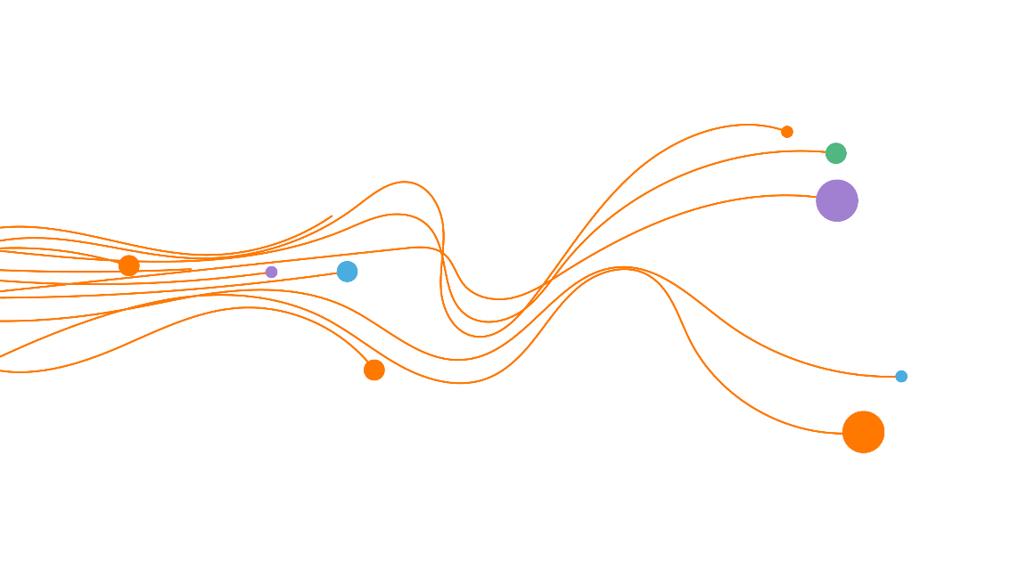
Services Flexible Engine
Container
Cloud Container Engine
Software Repository for Container
Application Orchestration Service
Intelligent EdgeFabric
Data Analysis
Map Reduce Service
Data Pipeline Service
Data Warehouse
Service
Data Ingestion Service
Machine Learning Services
Cloud Stream
Service
Cloud Search Service
ModelArts Services
Application
Services
Distributed Message Service
API
Simple Message Notification
Terraform
Service Stage
API Gateway

Slide 5


